Slide 1
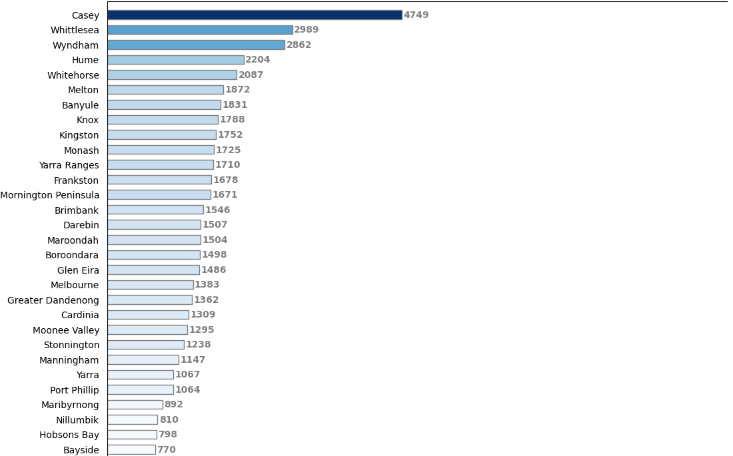
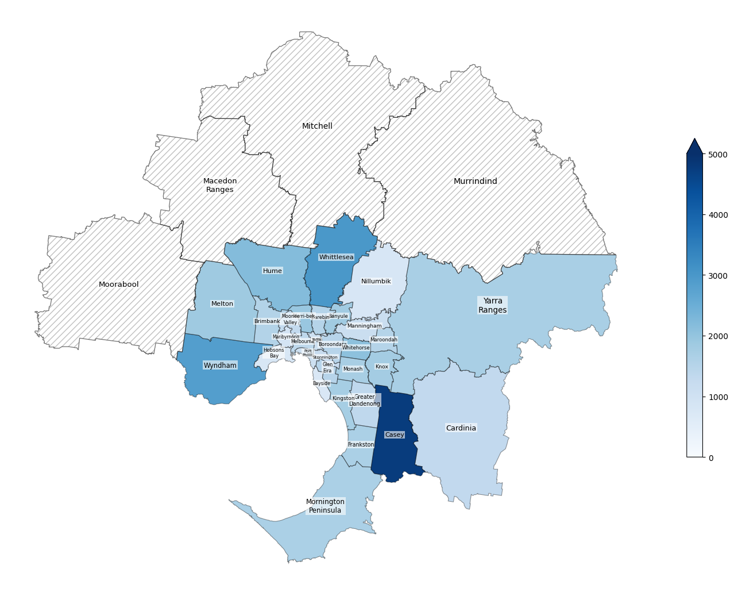

Where are the Night Workers residing in Greater Melbourne?
Number of workers
+
Local Government Areas
Number of workers
- Missing data
Data from ABS (Australian Bureau of Statistics) 2021 Censes, aggregated at LGA (Local Government Areas) level

Slide 2
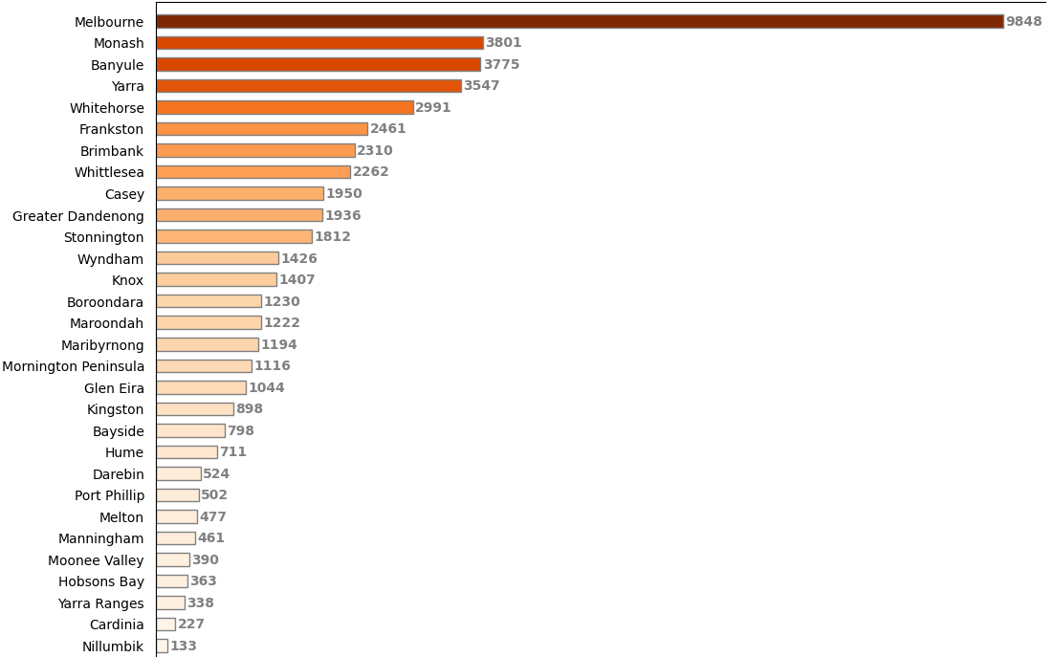
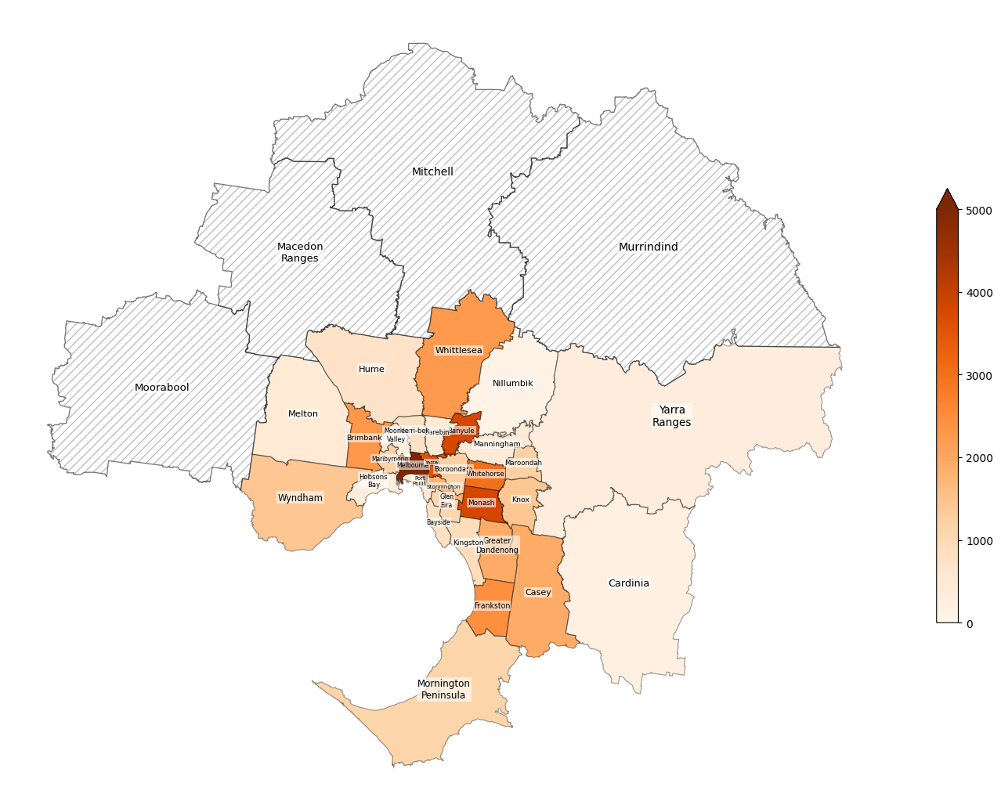
Where are the Night Workers working in Greater Melbourne?
Number of workers
+
Local Government Areas
Number of workers
- Missing data
Data from ABS (Australian Bureau of Statistics) 2021 Censes, aggregated at LGA (Local Government Areas) level

Slide 3
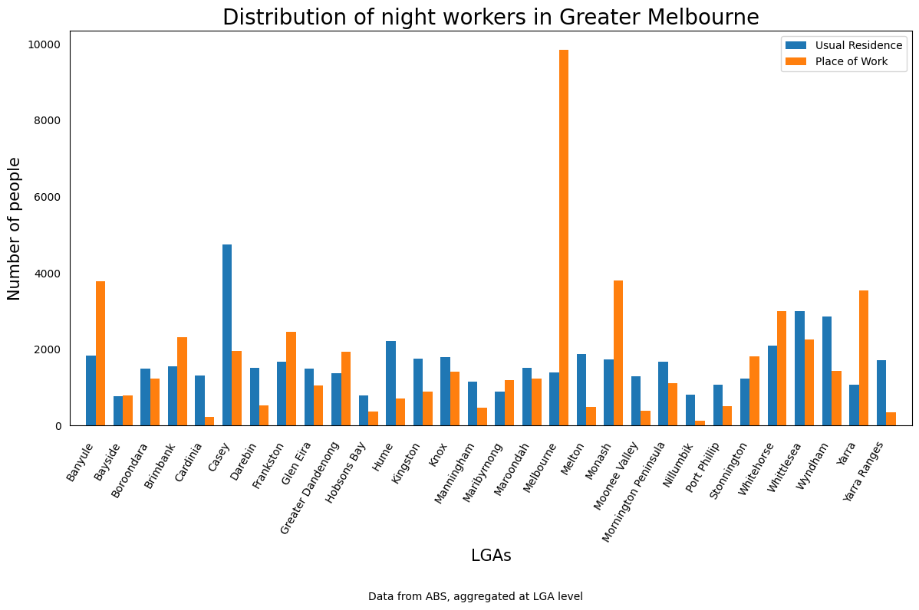
Grouped comparison of usual residence and place of work of Night Workers
Number of workers
Local Government Areas
Data from ABS (Australian Bureau of Statistics) 2021 Censes, aggregated at LGA (Local Government Areas) level

Slide 4
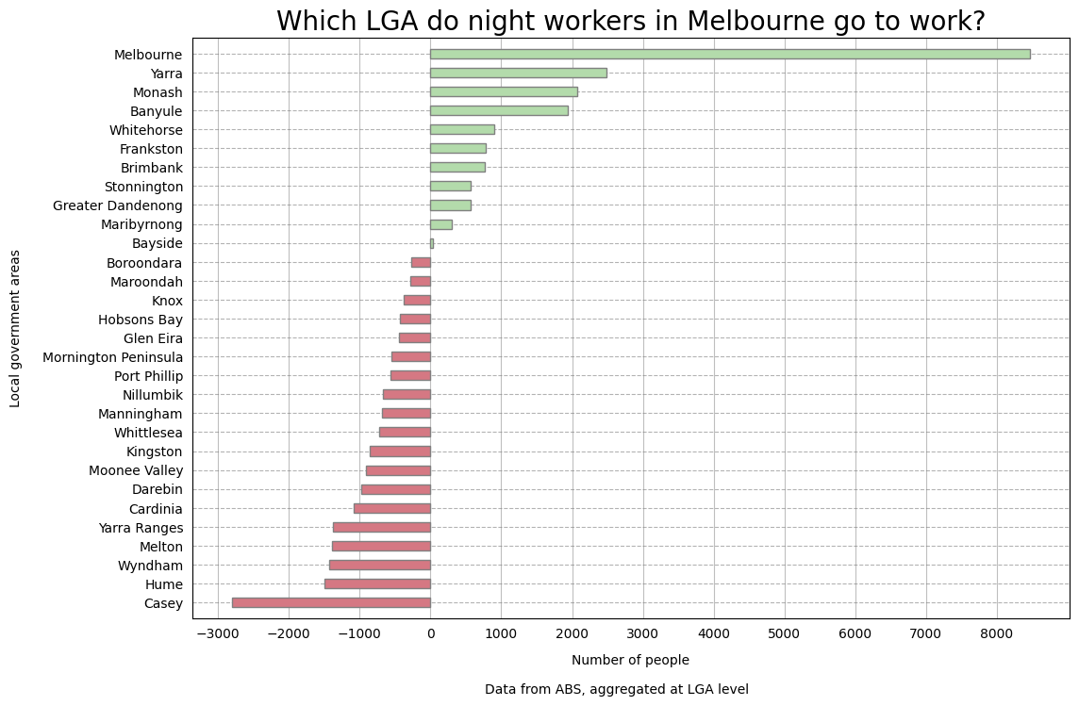
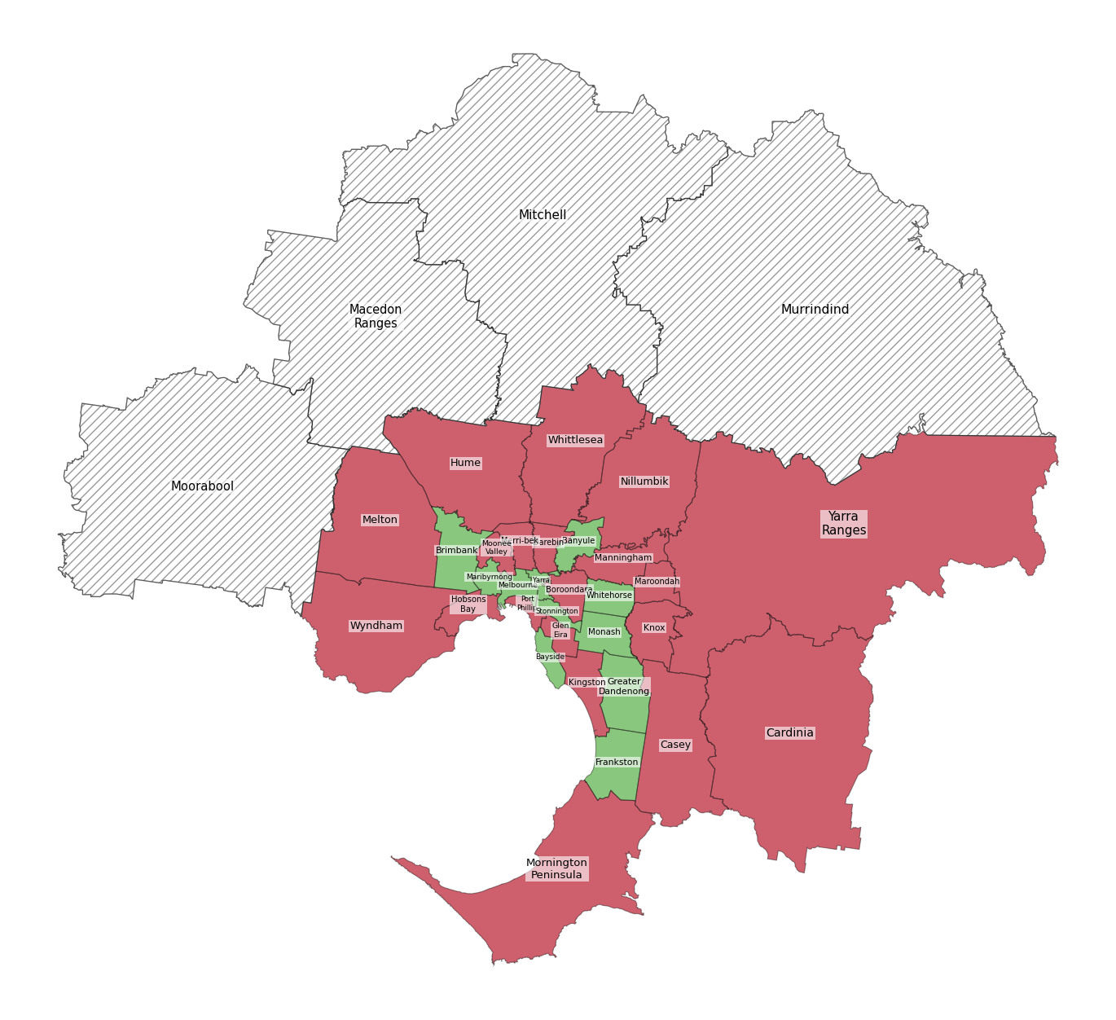
Which areas in Greater Melbourne do the Night Workers go more for work?
Local Government Areas
Net Increase in number of workers
- More Night Workers are coming here for work
- More Night Workers are leaving here for work
- Missing data
Data from ABS (Australian Bureau of Statistics) 2021 Censes, aggregated at LGA (Local Government Areas) level

Slide 5
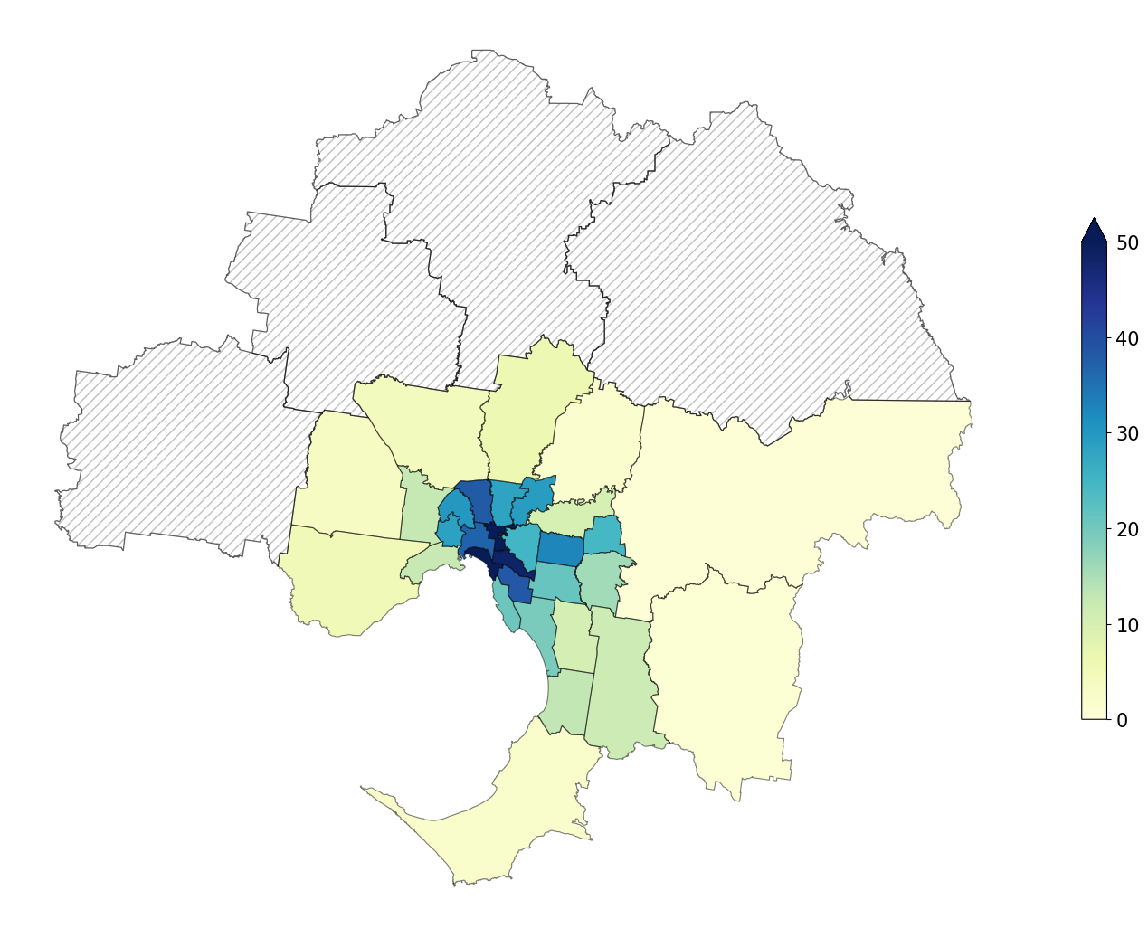
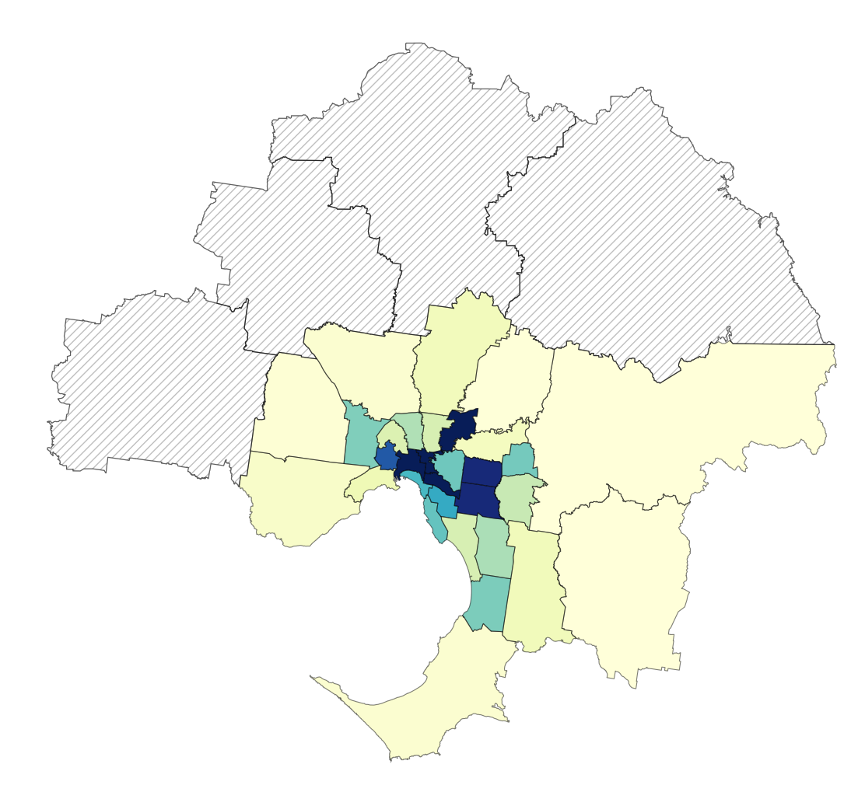

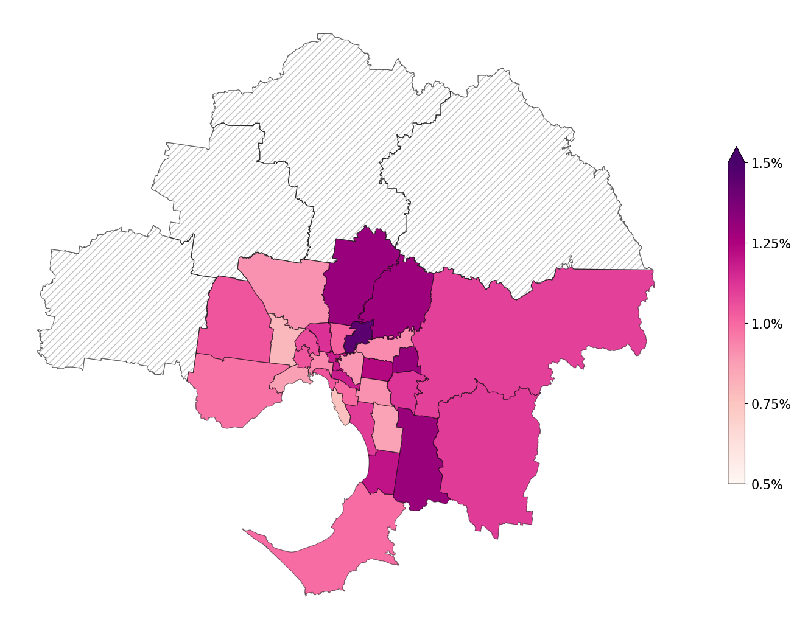
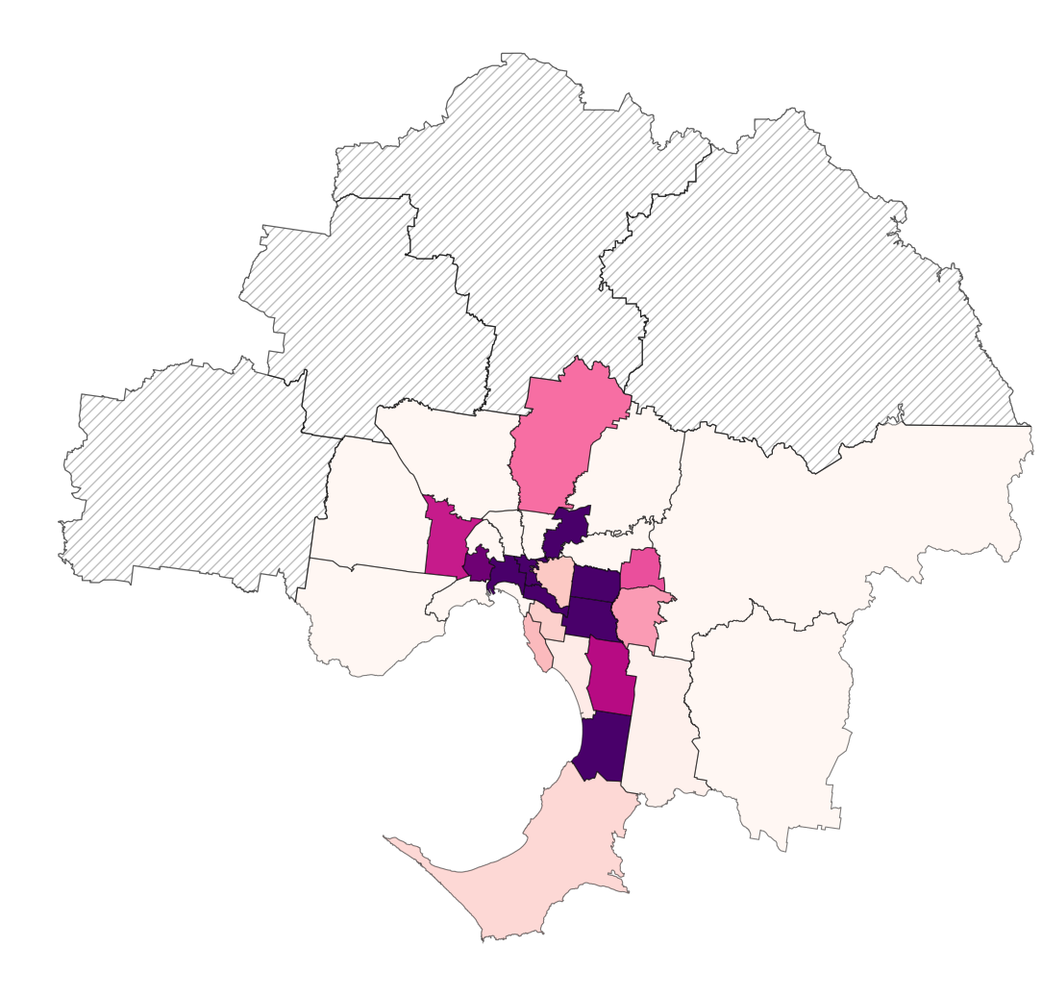
Night Workers density in Greater Melbourne
Number of workers / Area size in km²
+
Usual residence
Place of work
Night Workers–to–population ratio in Greater Melbourne
- Missing data
Number of workers / Population
+
Usual residence
Place of work
Data from ABS (Australian Bureau of Statistics) 2021 Censes and from https://en.wikipedia.org/wiki/Local_government_areas_of_Victoria, aggregated at LGA (Local Government Areas) level

